Slide 1
Development & accuracy analysis of structured light 3D scanner based on fringe projection technique
Pranav Kant Gaur Computer Division

Slide 2
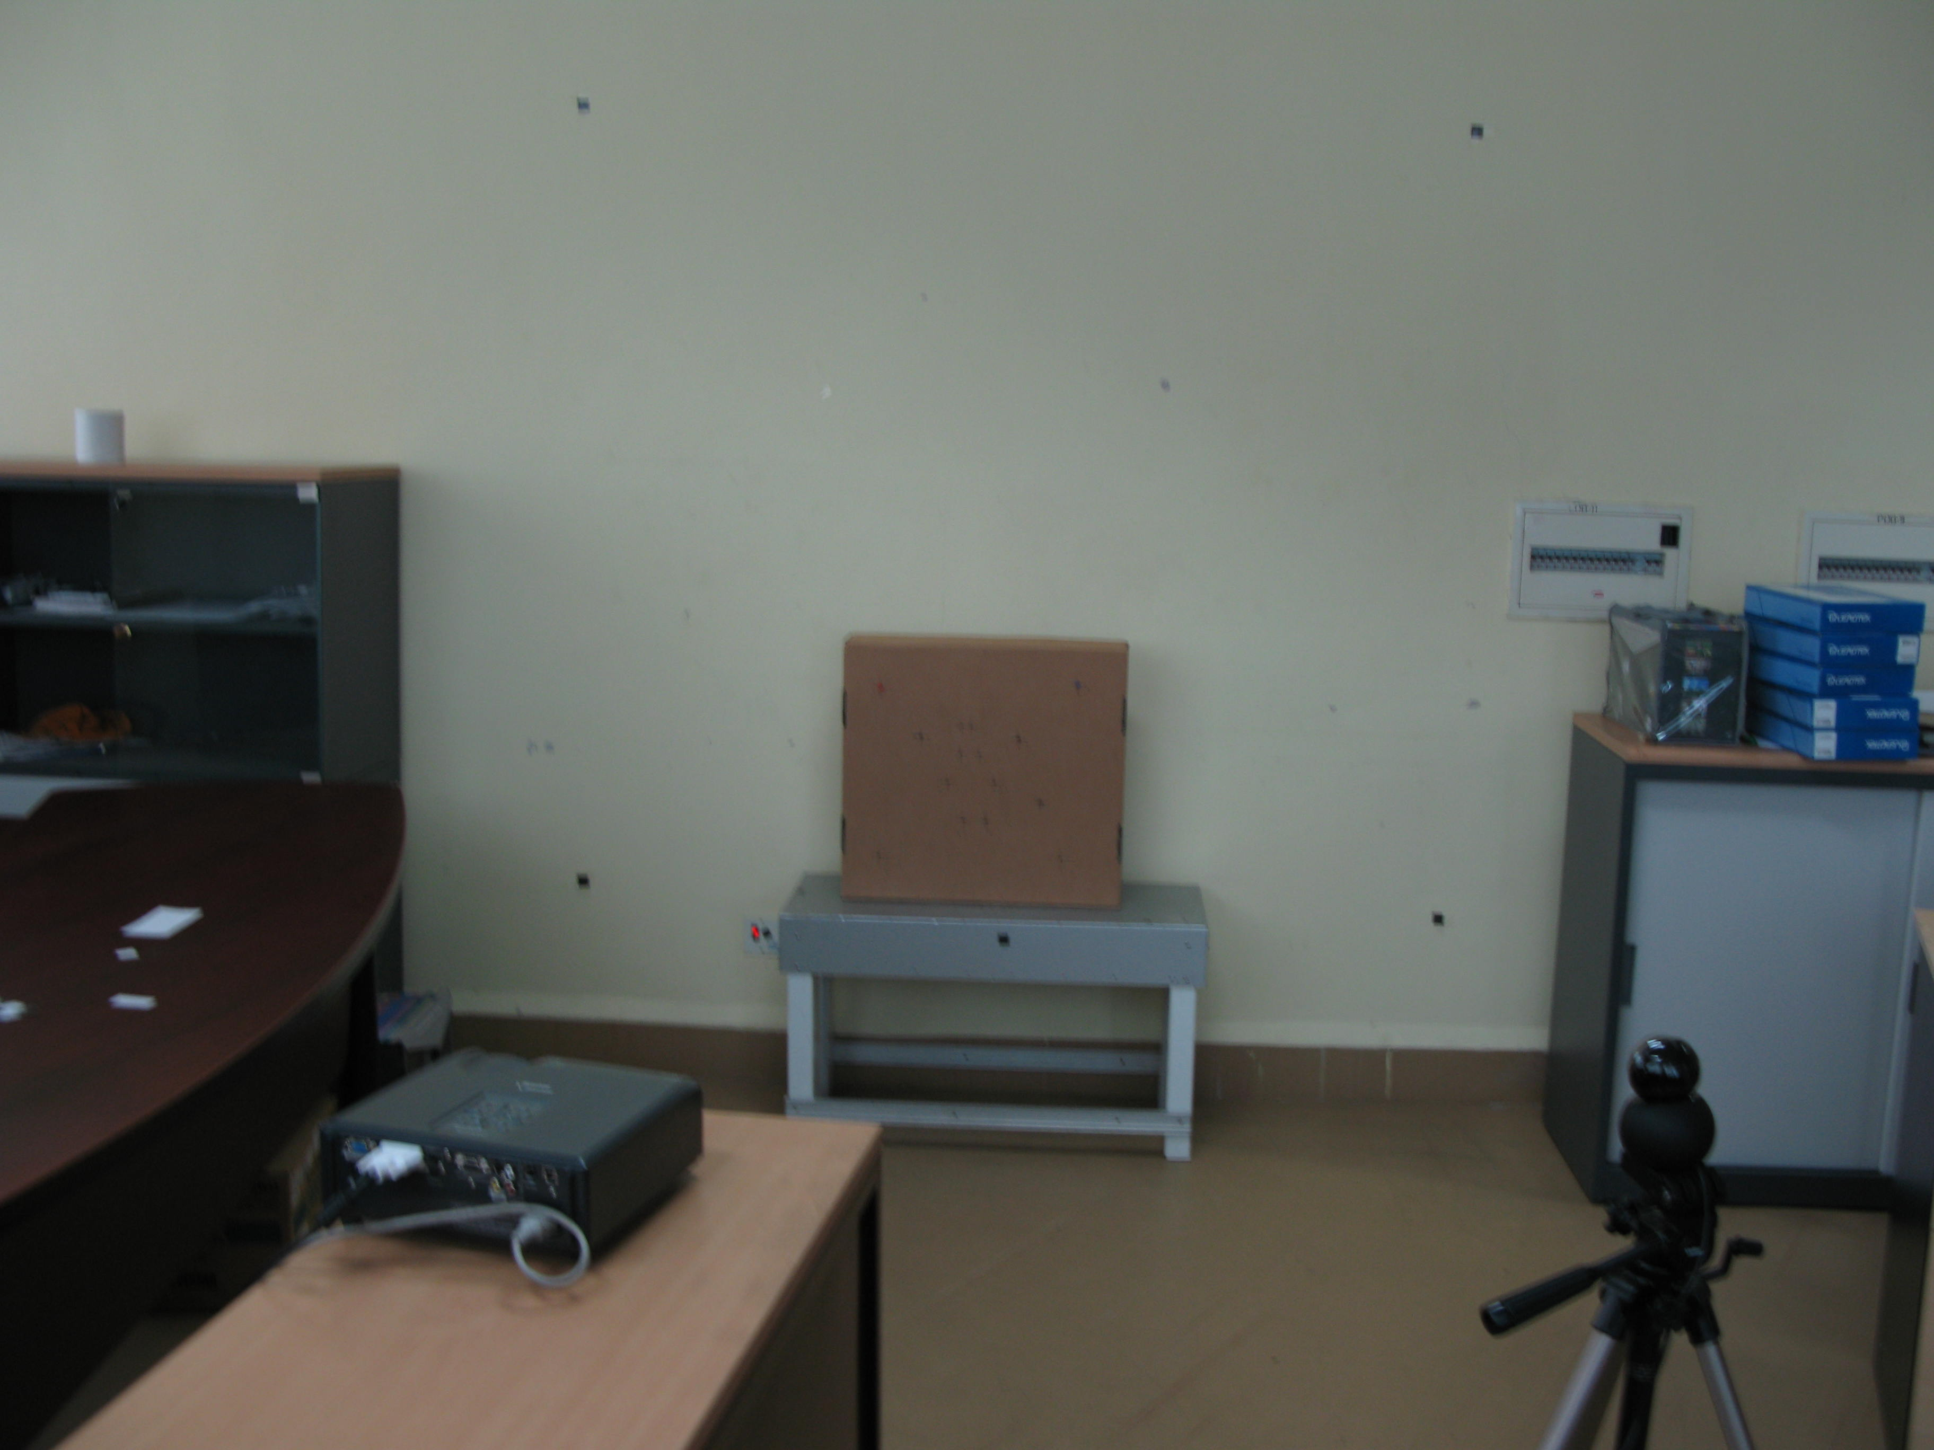
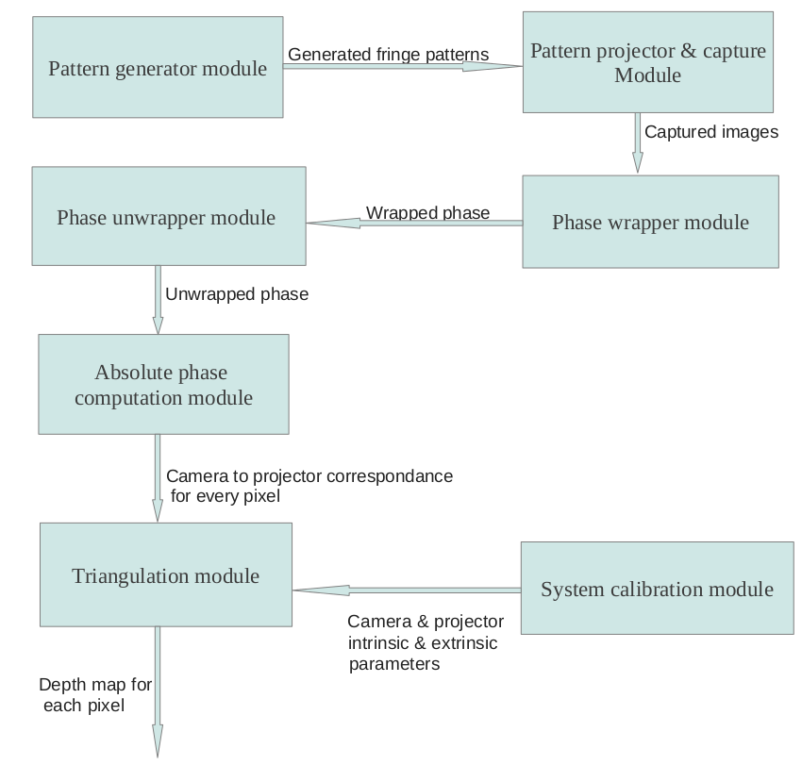
System details
System setup Software components

Slide 3












Pattern generation
Fringe patterns
Binary coded patterns(for decoding fringe period number)

Slide 4
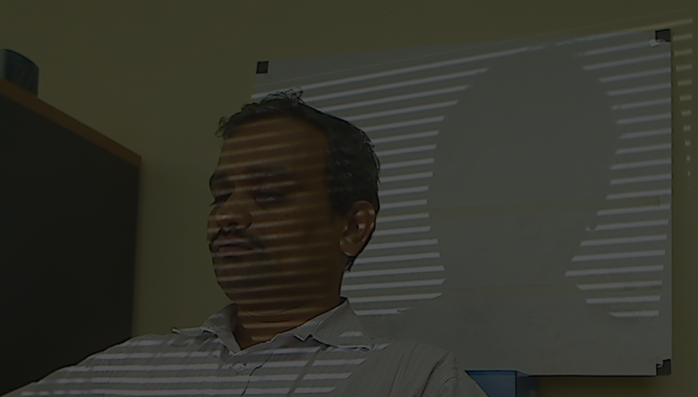
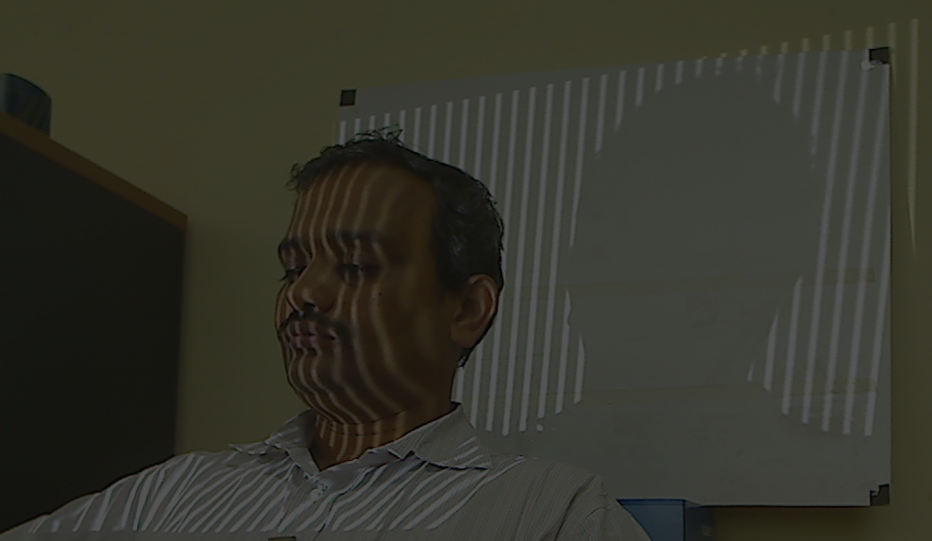
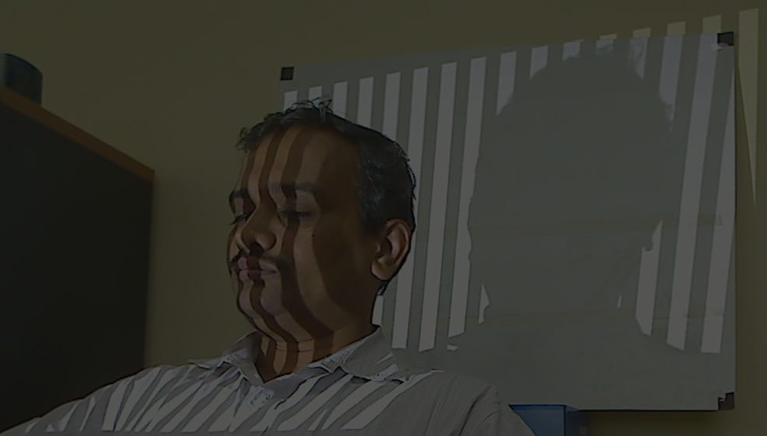
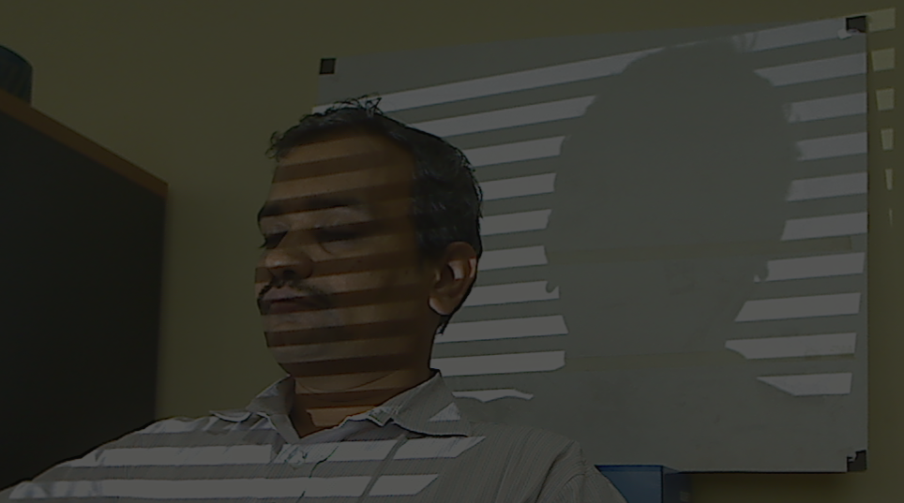
Pattern projection
Phase shift patterns
Binary coded patterns

Slide 5
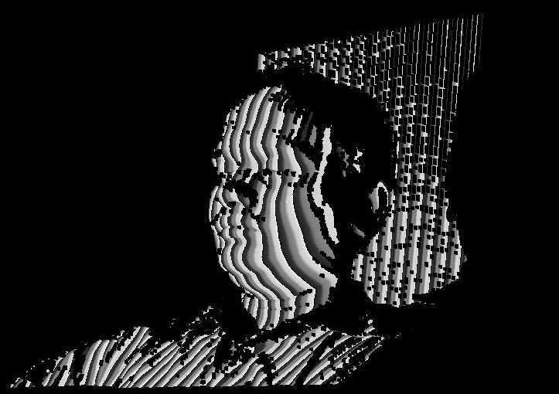
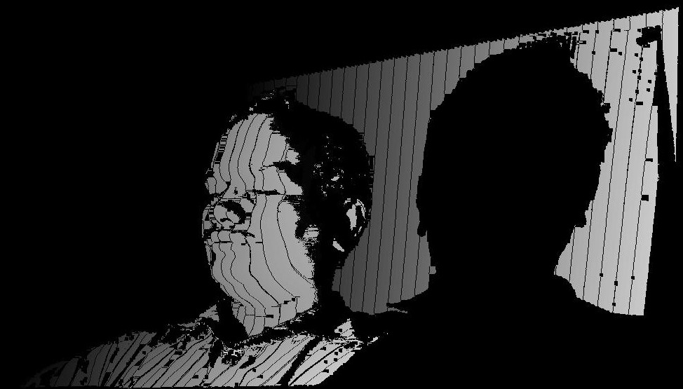

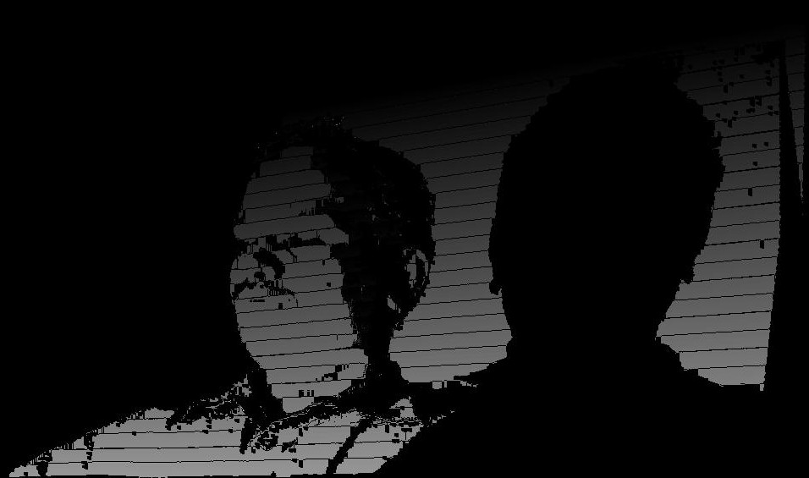
Wrapped & unwrapped phase
Vertical wrapped & unwrapped phrase
Horizontal wrapped & unwrapped phase

Slide 6
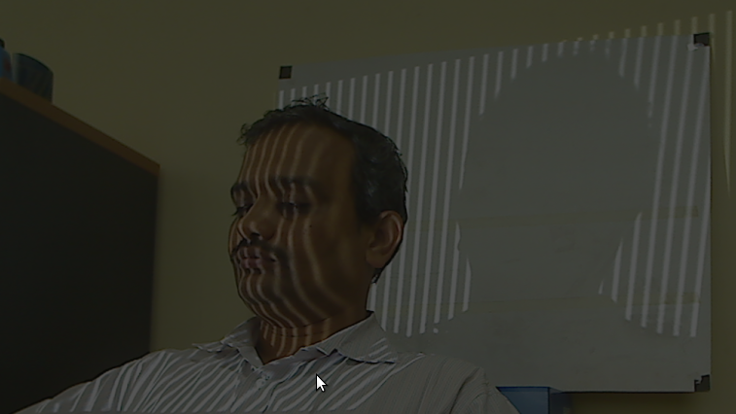

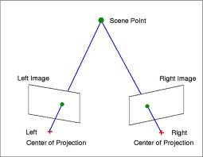
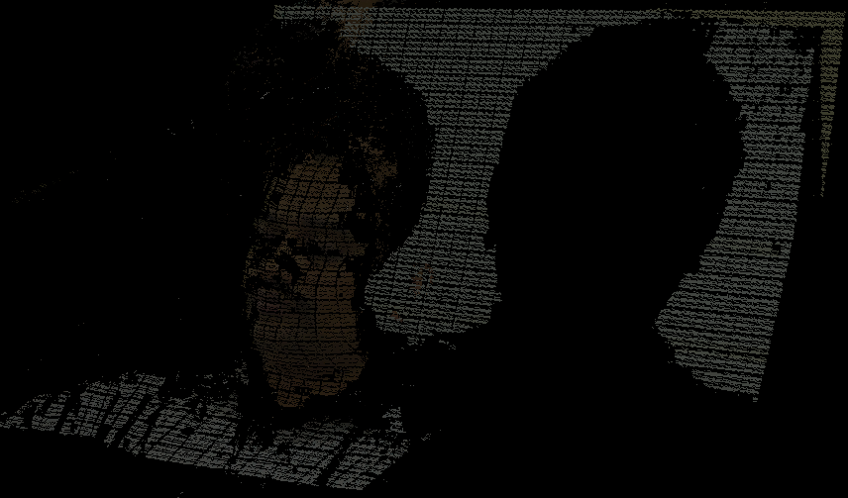
Correspondence & triangulation
Camera pixel Projector pixel
For metric reconstruction,optical ray must be defined for each camera & projector pixel in common coordinates system,which are estimated through system calibration.

Slide 7
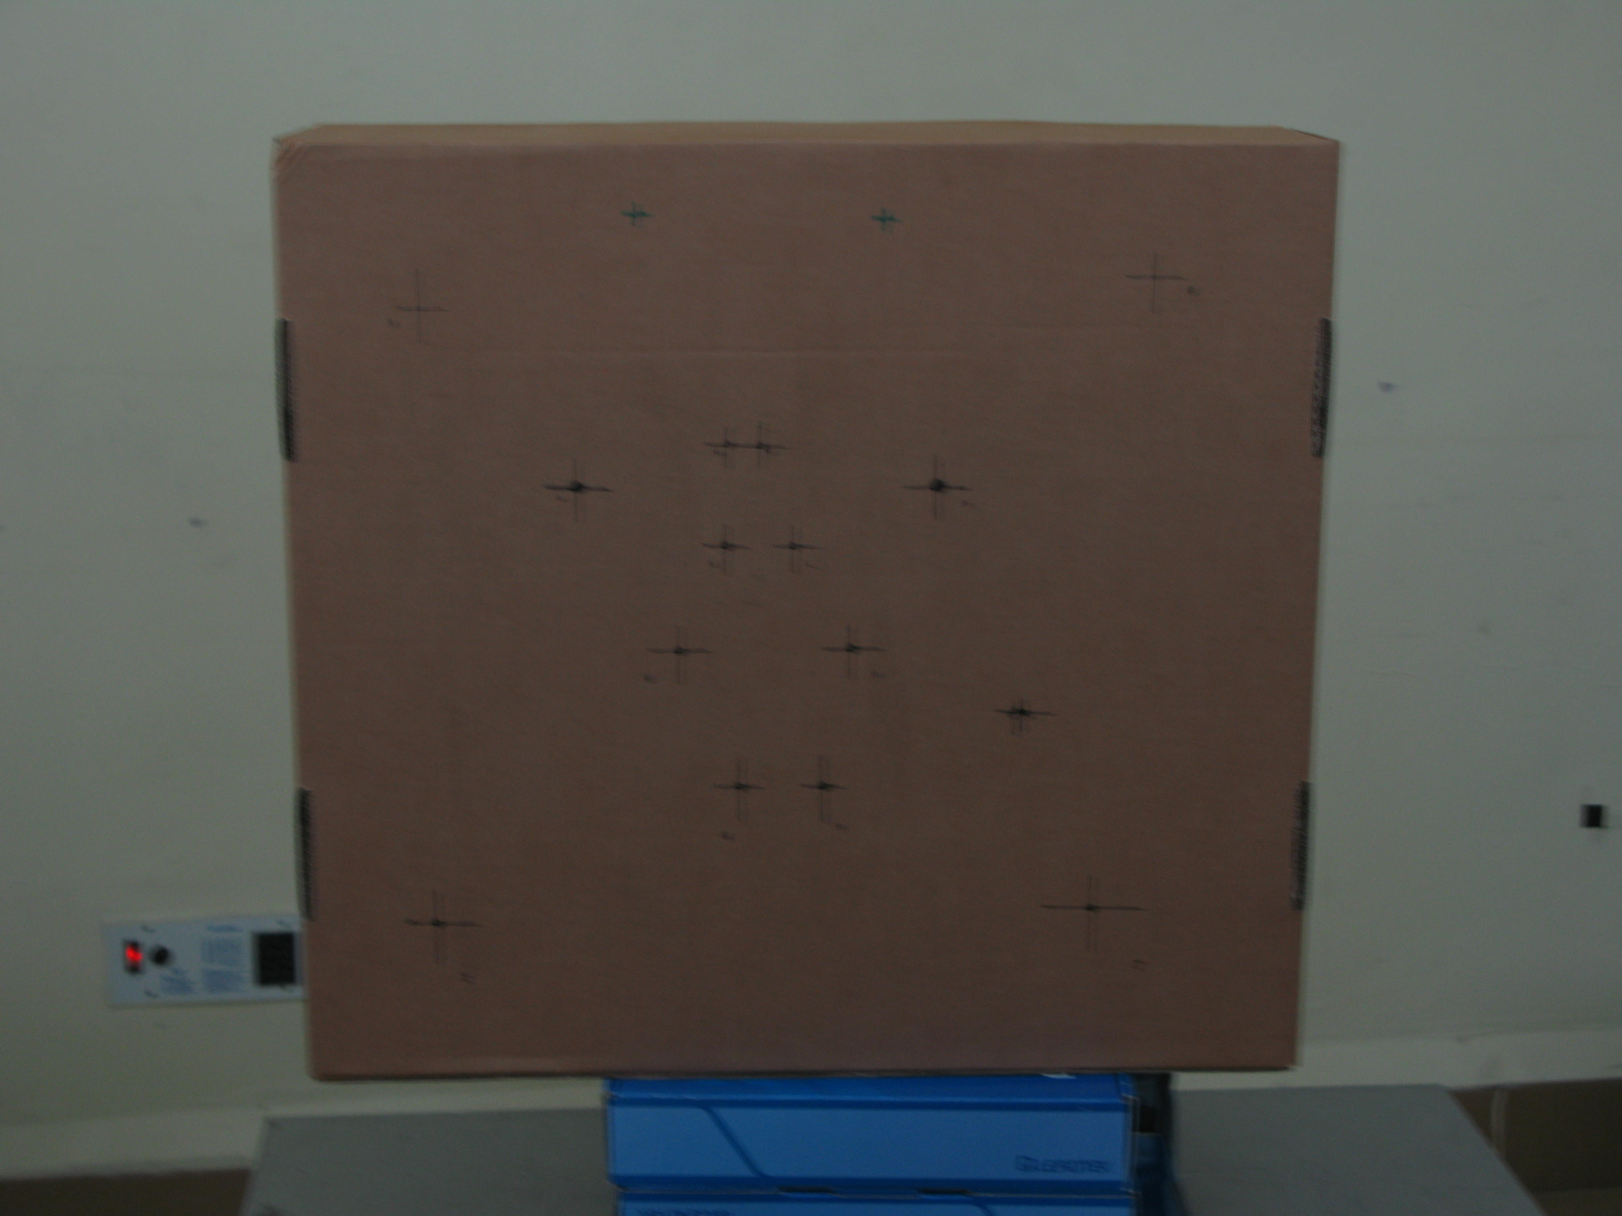
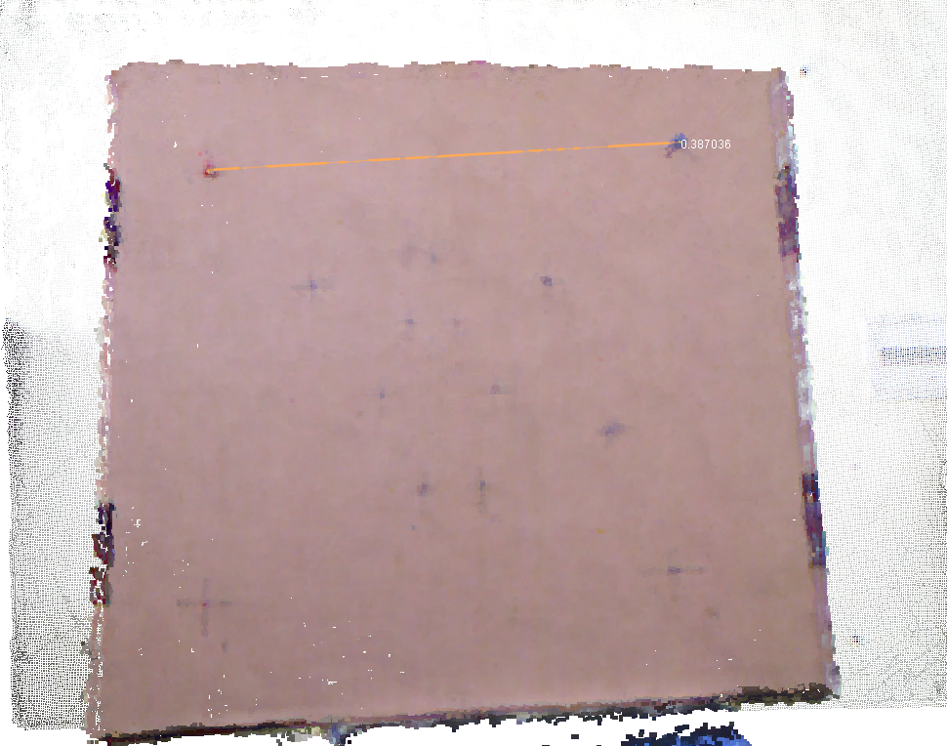
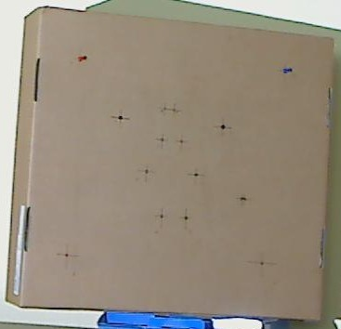
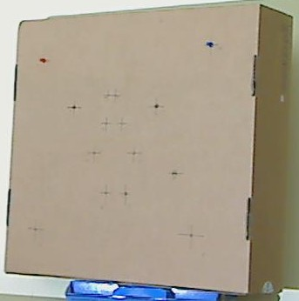
Accuracy evaluation
Views of measured object Measurement on point cloud Sources of error
1.Inaccurrate system calibration 2.Non-linearity of projector-camera system(gamma)
Measurement results:
Distance from camera | Average error
~1.9 m | ~3.32 mm
~1.7 m | ~5.95 mm
~1.4 m | ~3.74 mm
~1.1 m | ~5.59 mm
~0.8 m | ~7.06 mm

Slide 8

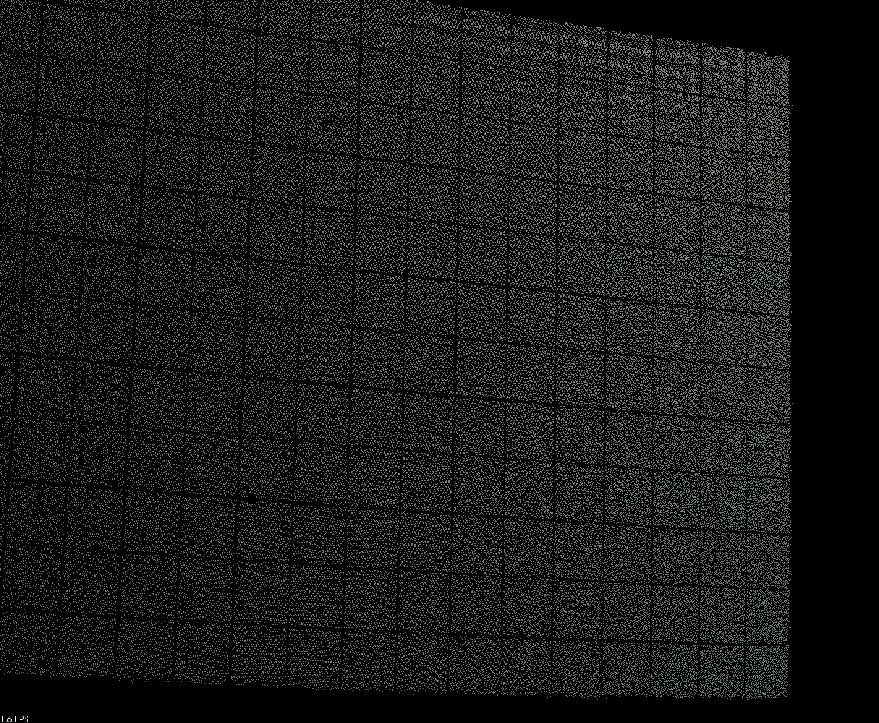
Effect of gamma on reconstruction
Without gamma correction With gamma correction

Slide 9
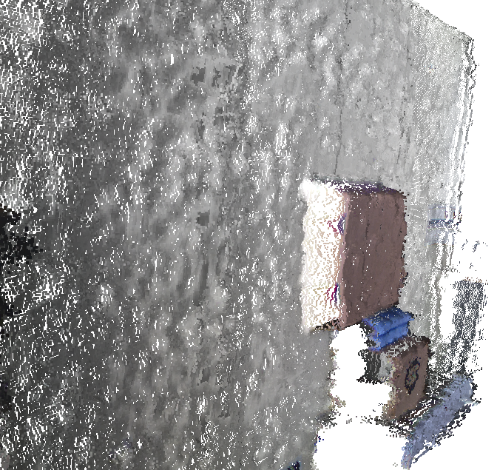
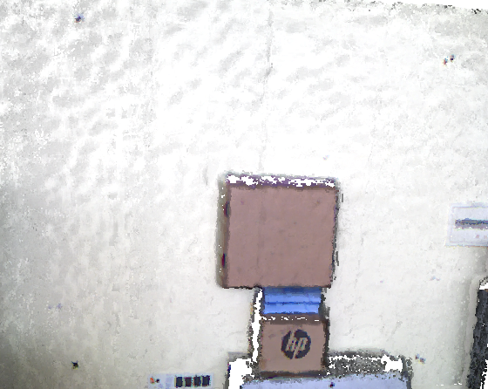
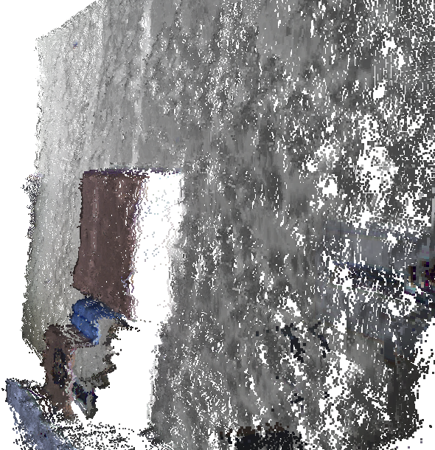
Measurement accuracy comparision with Microsoft Kinect
Kinect reconstruction at a distance of ~1.9 m:
Left view Front view Right view

Slide 10
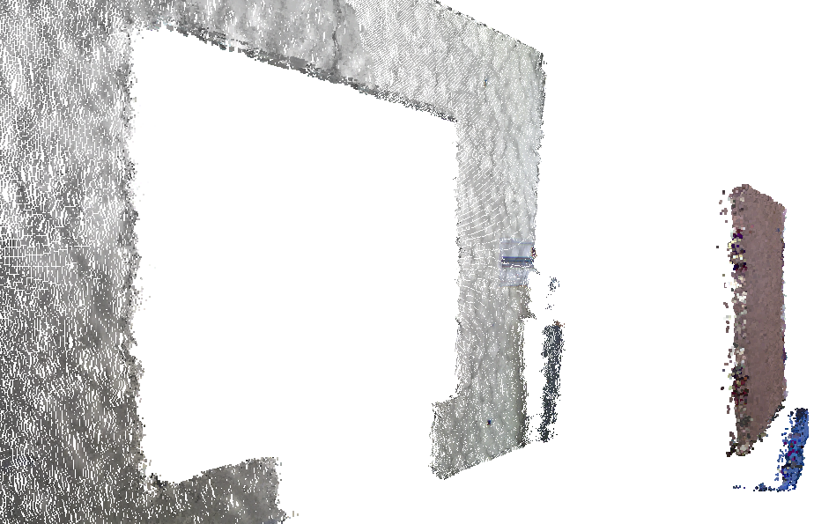
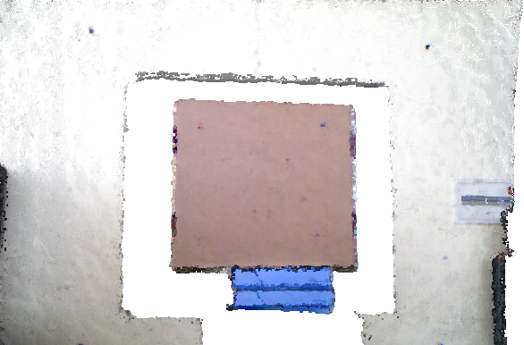
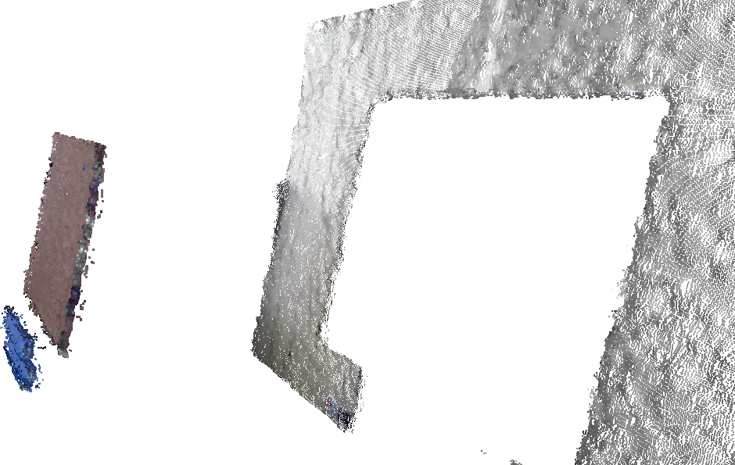
Kinect reconstruction of object at ~0.8m:
Left view Front view Right view

Slide 11
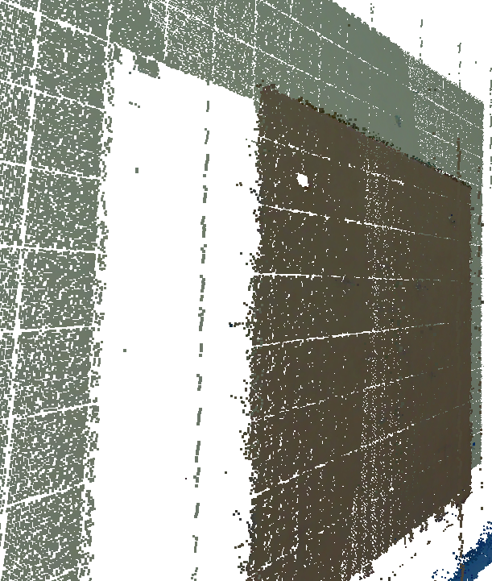
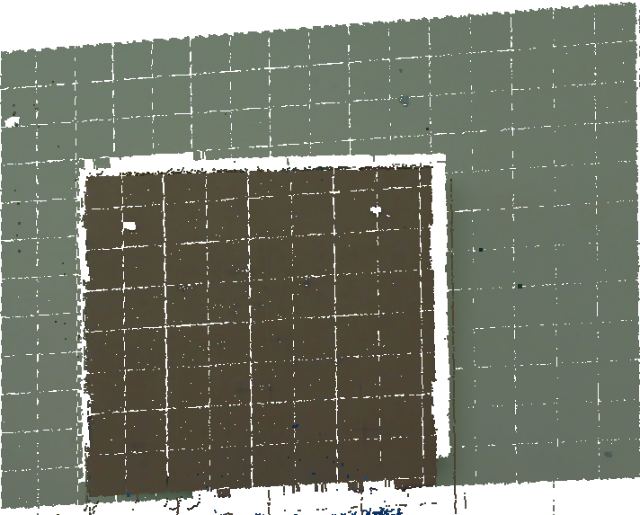
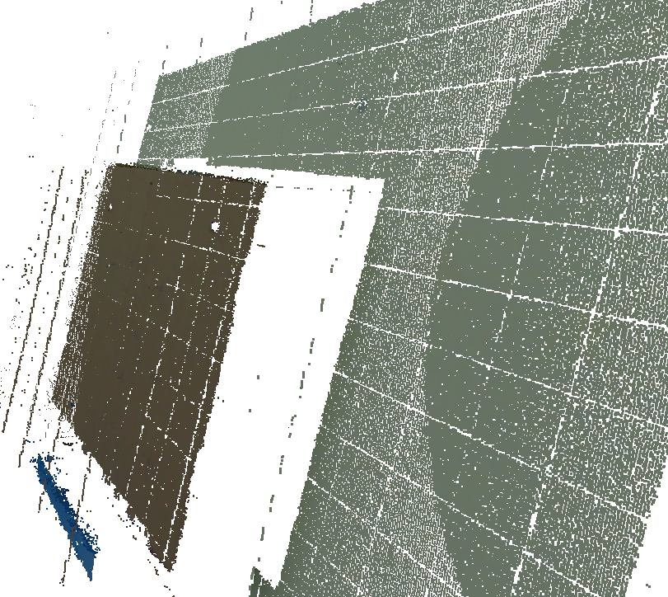
Our system at ~1.9m:
Left view Front view Right view

Slide 12
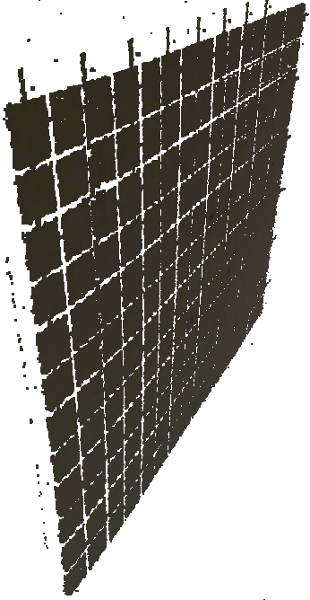

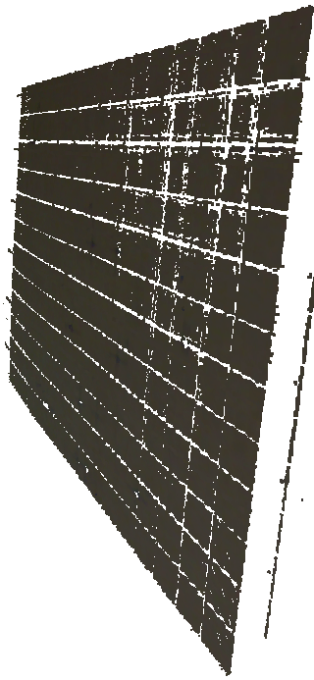
Our system at ~0.8m:
Left view Front view Right view

Slide 13
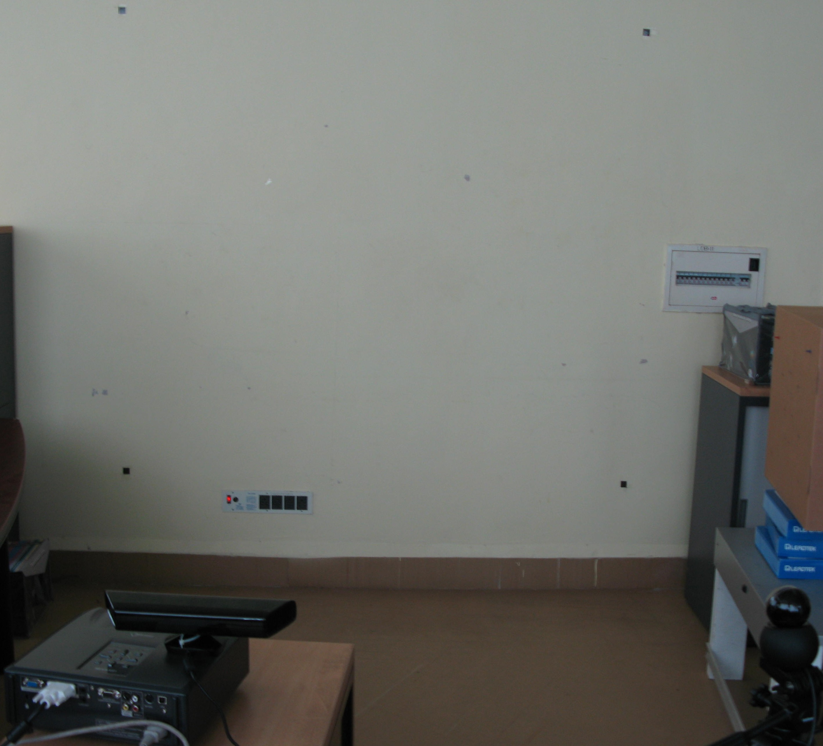
Comparision
Setup Results
Distance from camera(Our system) | Average absolute error
~1.9 m | ~3.32 mm
~1.7 m | ~5.95 mm
~1.4 m | ~3.74 mm
~1.1 m | ~5.59 mm
~0.8 m | ~7.06 mm
Distance from Kinect | Average absolute error
~1.9 m | ~12.2 mm
~1.7 m | ~10.6 mm
~1.4 m | ~5.24 mm
~1.1 m | ~4.44 mm
~0.8 m | ~3.67 mm

Slide 14
Work to be done
Reperform system calibration experiments
Reevaluate mesurement accuracy after using re-estimated calibration values
Both tasks collectively require 3-4 days of experimention

